Slide 1
A method to determine the size of the resampled data in imbalanced classification
Matthew Bonas; Son Nguyen, Ph. D.
Bryant University

Slide 2
Outline
What is imbalanced data?
Oversampling v. Undersampling
Multiple Resampling
Random Forests
Credit Card Fraud Dataset
Initial Resampling Results & Models
Multiple Resampling Results (Credit Card)
Car Accident Dataset
Multiple Resampling Results (Car Accident)
Overfitting?
Overfitting Results
When should oversampling be used?
Future Study

Slide 3
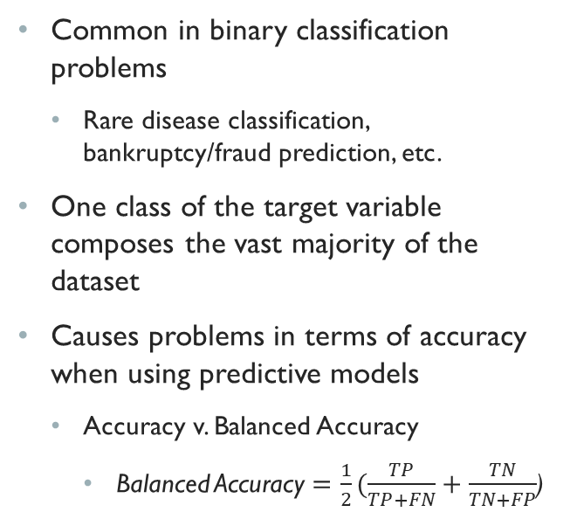
What is imbalanced Data?
Common in binary classification problems
Rare disease classification, bankruptcy/fraud prediction, etc.
One class of the target variable composes the vast majority of the dataset
Causes problems in terms of accuracy when using predictive models
Accuracy v. Balanced Accuracy
Balanced Accuracy $=\frac{1}{2}(\frac{TP}{TP+FN}+\frac{TN}{TN+FP}$)
Notes:
Questions: How many of you are familiar with binary classification?
I have a model which is 99% accurate, who thinks this is a good model?

Slide 4
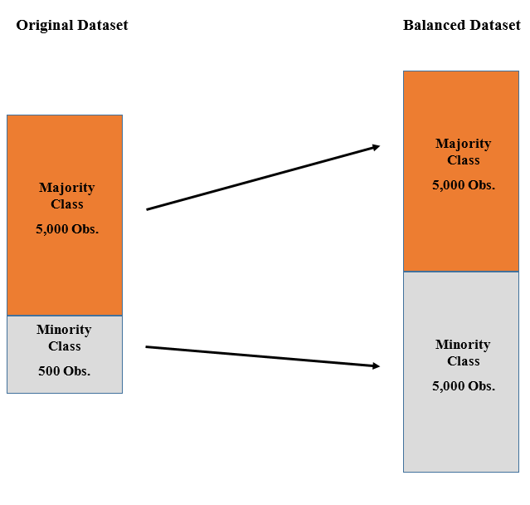
Oversampling v. Under-sampling
Oversampling is done by adding additional minority class observations to the dataset until it is balanced
Allows for all of the data to be retained but it can take a long time to complete
Duplication, synthetic creation, etc.
i.e. SMOTE and ROS
Golas, Edward. “Bankruptcy Prediction Using Multiple Under-Sampling: A Study of North American Companies.” Bryant University, 2018

Slide 5
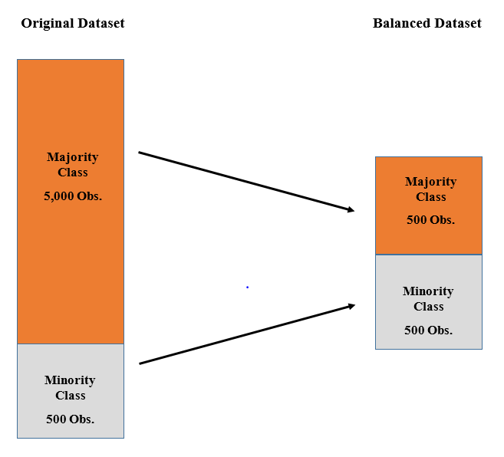
Oversampling v. under-sampling
Undersampling is done by removing majority class observations until the dataset is balanced
Completes in a relatively short amount of time but a large amount of data is lost from removal
Random selection, nearest neighbors, etc.
i.e. Tomek Links, RUS, Cluster Centroids
Golas, Edward. “Bankruptcy Prediction Using Multiple Under-Sampling: A Study of North American Companies.” Bryant University, 2018

Slide 6
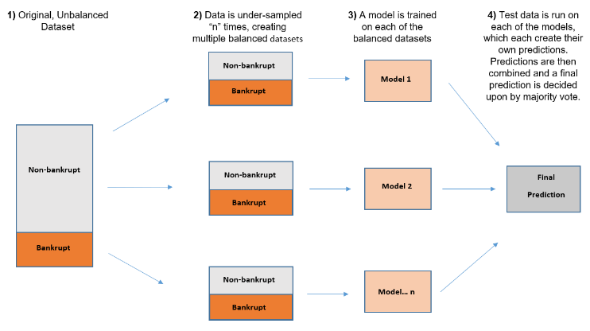
Multiple Resampling
S-value = #of observations in each target category in the resampled dataset
S-value = size of minority class
Undersampling
S-value = size of majority class
Oversampling
Golas, Edward. “Bankruptcy Prediction Using Multiple Under-Sampling: A Study of North American Companies.” Bryant University, 2018

Slide 7
What s-Value gives you the best results?

Slide 8
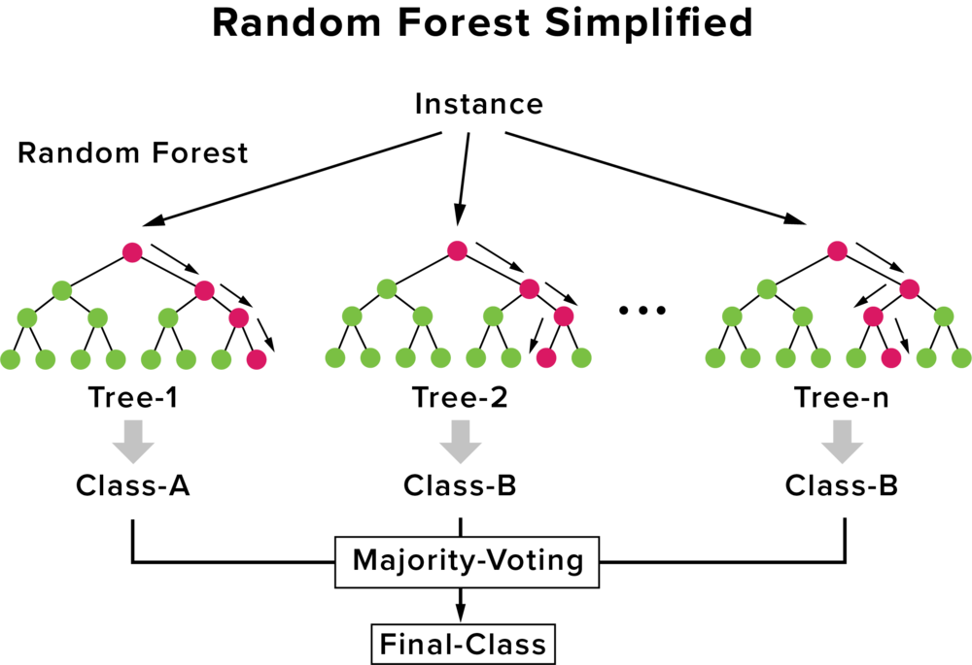
Random Forest Model
Random Forests were used with the different resampling methods
Initial testing revealed that random forest performed better (and faster) in terms of balanced accuracy versus other types of predictive models
i.e. Decision Tree, Support Vector Machines, Neural Networks
Random Forests are a collection of decision trees
A random sample of data is used to train the trees, with the rest of the data being used for estimating error and variable importance
The final result is formed by taking a vote of the results each individual tree got

Slide 9
Credit Card Fraud Dataset
Credit Card Fraud dataset obtained from Kaggle
284,807 observations with 31 variables
Observations represent purchases made over a 2 day period in September 2013
Time, Amount, Class (target), V1-V28
V1-V28 are PCA variables already created for data privacy reasons
Target Variable Distribution
Class 0 (Not Fraudulent): 99.83%
Class 1 (Fraudulent): 0.17%

Slide 10
Resampling Methods
Numerous resampling methods were initially used to balance the data
Oversampling Methods
Synthetic Minority Oversampling Technique (SMOTE)
Random Oversampling
Undersampling Methods
Tomek Links
Cluster Centroids
Random Under-Sampling
Model | Balanced Accuracy
Random Under-sampling | 0.947
SMOTE | 0.918
Random Oversampling | 0.905
Tomek Links | 0.899
Cluster Centroids | 0.536

Slide 11
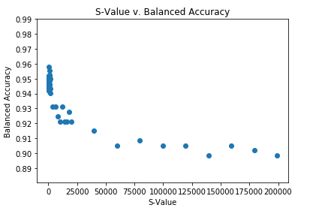
Credit Card Fraud Results

Slide 12
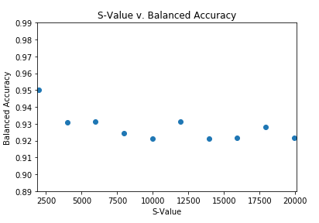
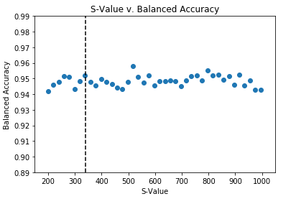
More Results

Slide 13
Car Accident Dataset
Contains a list of car accidents throughout the United States from 2015
Approximately 81,000 observations with 28 variables
Target Variable: DEFORMED (major damage, minor/no damage)
Other variables include weather, time, month, object hit, age, gender, state, etc.

Slide 14
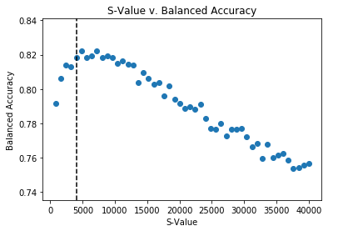
Car Accident Results

Slide 15
Overfitting?
Overfitting occurs when the model learns the noise and the extensive detail in the training data to the point that it negatively impacts the performance of the model overall
The noise and randomness of the training data is learned by the model
Does not apply to any new data being tested by the model which will then negatively impact the models predictive power
Random forests themselves do not overfit the data solely based on the number of trees in the forest

Slide 16
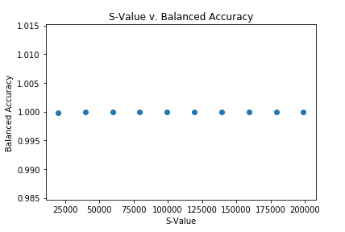
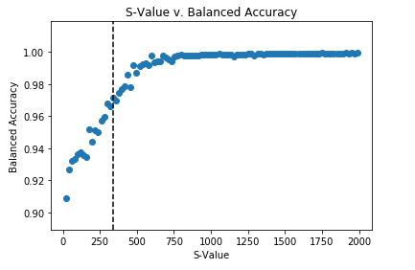
Overfitting Results (Credit Card)

Slide 17
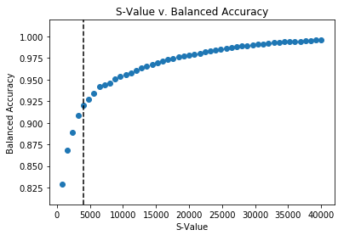
Overfitting Results (Cars)

Slide 18
When should Random Oversampling be used?
Initial hypothesis was that with smaller datasets ROS would not have a negative effect of the predictive power relative to RUS
NBA Hall of Fame dataset
Approx. 1500 observations with 74 variables (including dummy variables)
98.9% majority (not in HOF) and 1.1% minority (in HOF)

Slide 19
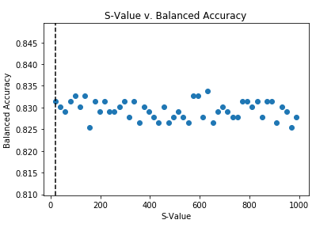
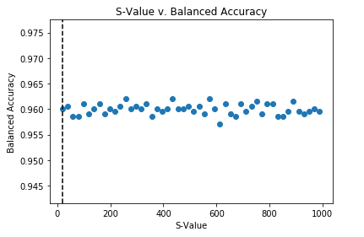
Basketball Results
Notes:
Testing dataset is on the left
Training dataset in on the right

Slide 20
Conclusion
When resampled, most models had the highest balanced accuracy around the area of random undersampling
As the S-Value of the resampled data increases the balanced accuracy of the model decreased in larger datasets
Random undersampling performed as well, if not better, than random oversampling in all cases
RUS also takes less time to complete v. ROS
The function created allows the user to test any dataset to see which S-Value is optimal for that specific dataset

Slide 21
Future Study
Different resampling methods to be used during multiple resampling
Comparison to performance by ROS and RUS
Explore how different resampling methods compare in terms of overfitting the model versus ROS
Using different predictive models within the function to see if they are optimized at different S-Values
Support Vector Machines, Neural Networks, etc.

Slide 22
Thank you! Any Questions?
Further Questions?
Contact me at:
mbonas@bryant.edu

